Slide 1
Linear Programming

Slide 2
Introduction
Mathematical programming is used to find the optimal solution to a problem that requires a decision or set of decisions about how best to use a set of limited resources to achieve a state goal of objectives.
Steps involved in mathematical programming
  Conversion of stated problem into a mathematical model that abstracts all the essential elements of the problem.
  Exploration of different solutions of the problem.
  Finding out the most suitable or optimum solution.
Linear programming requires that all the mathematical functions in the model be linear functions.

Slide 3
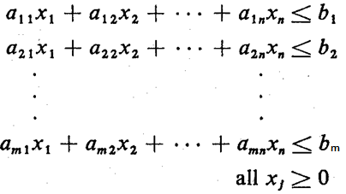
The Linear Programming Model (1)
Let: X₁, X₂, X₃, ………, X_{n} = decision variables
    Z = Objective function or linear function
Requirement: Maximization of the linear function Z.
  Z = c₁X₁ + c₂X₂ + c₃X₃ + ………+ c_{n}X_{n} …..Eq (1)
  subject to the following constraints:
…..Eq (2)
where a_{ij}, b_{i}, and c_{j} are given constants.

Slide 4
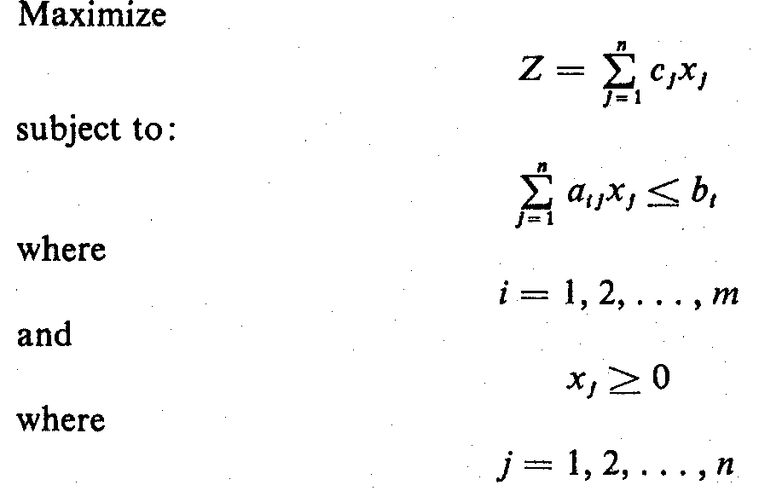
The Linear Programming Model (2)
The linear programming model can be written in more efficient notation as:
…..Eq (3)
The decision variables, x_{I}, x₂, ..., x_{n}, represent levels of n competing activities.

Slide 5
Examples of LP Problems (1)
1. A Product Mix Problem
A manufacturer has m different resource materials (B₁, B₂, ... B_{m}), where the amount of material B_{i} is b_{i}, i=1,2,...,m.
These resources can be combined to produce any one of several different products (P₁, P₂, ... P_{n}). The price of one unit of product P_{j} is c_{j}, j=1, 2, ...,n.
The quantity of the i^{th} resource required to produce one unit of the j^{th} product is known as a_{ij}.
The decision maker wishes to produce the combination of products that will maximize total income.
c₁x₁ + c₂x₂ + ... + c_{n}x_{n} -> max, where x_{j} is amount of P_{j} unit.

Slide 6
Examples of LP Problems (2)
2. A Production Scheduling Problem
A manufacturer knows that he must supply a given number of items of a certain product each month for the next n months.
They can be produced either in regular time, subject to a maximum each month, or in overtime. The cost of producing an item during overtime is greater than during regular time. A storage cost is associated with each item not sold at the end of the month.
The problem is to determine the production schedule that minimizes the sum of production and storage costs.

Slide 7
Examples of LP Problems (3A)
3. A Transportation Problem
A product is to be shipped in the amounts a_{l}, a₂, ..., a_{m} from m shipping origins and received in amounts b_{l}, b₂, ..., b_{n} at each of n shipping destinations.
The cost of shipping a unit from the i^{th} origin to the j^{th} destination c_{ij} is known for all combinations of origins and destinations.
The problem is to determine the amount to be shipped from each origin to each destination such that the total cost of transportation is a minimum.

Slide 8
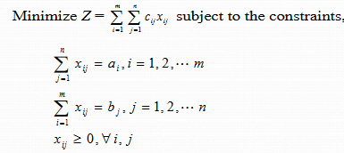
Examples of LP Problems (3B)
The Transportation Problem can be expressed mathematically as

Slide 9
Examples of LP Problems (5)
5. A Flow Capacity Problem
One or more commodities (e.g., traffic, water, information, cash, etc.) are flowing from one point to another through a network whose branches have various constraints and flow capacities.
The direction of flow in each branch and the capacity of each branch are known.
The problem is to determine the maximum flow, or capacity of the network.

Slide 10
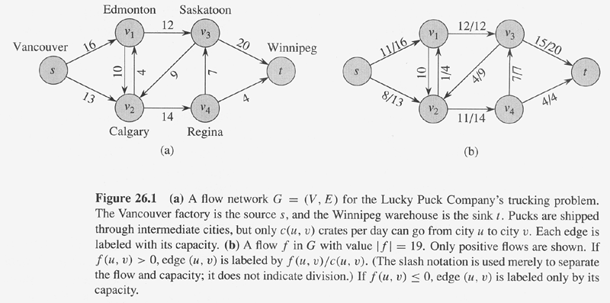
Example of max-flow problem

Slide 11
Formatting Max-flow problem as LPs
Maximize ∑_{v∈V} f(s,v) with constraints:
    for all u,v∈V, f(u,v)≤ c(u,v).
    for all u,v∈V, f(u,v)= -f(v,u).
    for all u∈V-{s,t}, ∑_{v∈V} f(u,v)=0.

Slide 12
Developing LP Model (1)
The variety of situations to which linear programming has been applied ranges from agriculture to zinc smelting.
Steps Involved:
  Determine the objective of the problem and describe it by an objective function in terms of the decision variables.
  Find out the constraints (≤, ≥, =)
  Do the analysis which should lead to the selection of values for the decision variables that optimize the criterion function while satisfying all the constraints imposed on the problem.

Slide 13
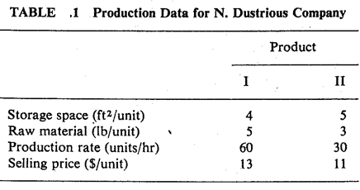
Developing LP Model (2)
Example: Product Mix Problem
The N. Dustrious Company produces two products: I and II. The raw material requirements, space needed for storage, production rates, and selling prices for these products are given in Table 1.
        Maximize: Z = 13x₁ + 11x₂
        (1) 4X₁ + 5X₂ ≤ 1500
        (2) 5x₁ + 3x₂ ≤ 1575
        (3) x₁ / 60 + x₂ / 30 ≤ 7
(3) x₁ + 2x₂ ≤ 420
The total storage space for all products is 1500 ft² (1). The total amount of raw material available per day for both products is 1575 pound (2), and a maximum of 7 hours per day (3) can be used for production.

Slide 14
Developing LP Model (3)
Problem
All products manufactured are shipped out of the storage area at the end of the day. Therefore, the two products must share the total raw material, storage space, and production time. The company wants to determine how many units of each product to produce per day to maximize its total income.
Solution
The company has decided that it wants to maximize its sale income, which depends on the number of units of product I and II that it produces.
Therefore, the decision variables, x₁ and x₂ can be the number of units of products I and II, respectively, produced per day.

Slide 15
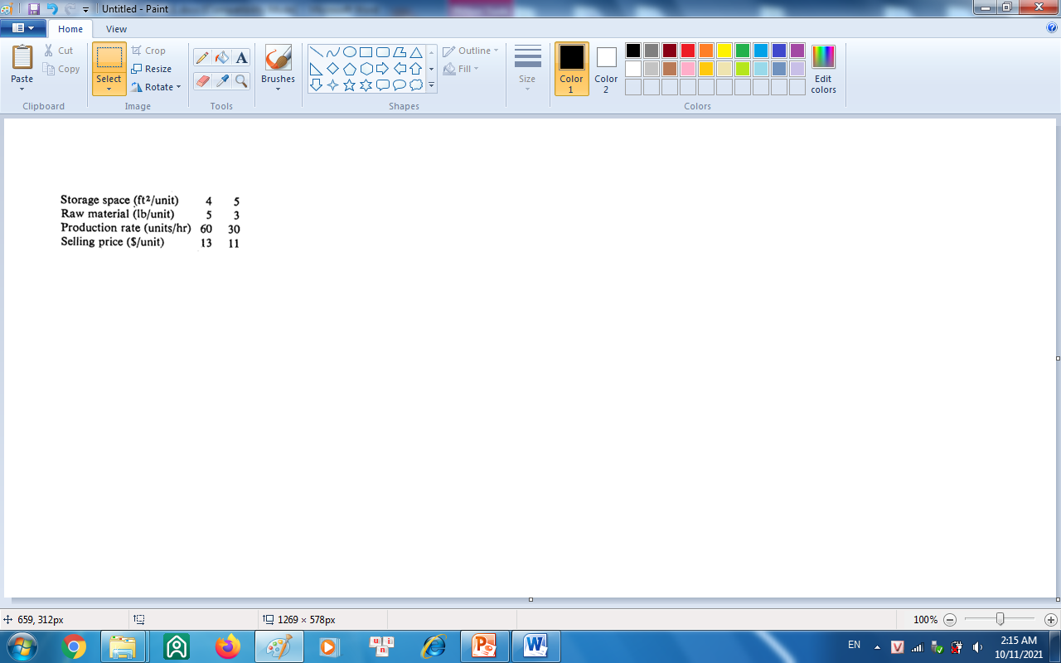
Developing LP Model (4)
The object is to maximize the equation:
        Z = 13x₁ + 11x₂
  subject to the constraints on storage space, raw materials, and production time.
Each unit of product I requires 4 ft² of storage space and each unit of product II requires 5 ft². Thus a total of 4x₁ + 5x₂ ft² of storage space is needed each day. This space must be less than or equal to the available storage space, which is 1500 ft². Therefore,
        4X₁ + 5X₂ ≤ 1500
Similarly, each unit of product I and II produced requires 5 and 3 lbs, respectively, of raw material. Hence a total of 5x_{l} + 3x₂ Ib of raw material is used.

Slide 16
Developing LP Model (5)
This must be less than or equal to the total amount of raw material available, which is 1575 Ib. Therefore,
        5x₁ + 3x₂ ≤ 1575
Product I can be produced at the rate of 60 units per hour. Therefore, it must take 1 minute or 1/60 of an hour to produce 1 unit. Similarly, it requires 1/30 of an hour to produce 1 unit of product II. Hence a total of x₁/60 + x₂/30 hours is required for the daily production. This quantity must be less than or equal to the total production time available each day. Therefore,
        x₁ / 60 + x₂ / 30 ≤ 7
      or x₁ + 2x₂ ≤ 420
Finally, the company cannot produce a negative quantity of any product, therefore x₁ and x₂ must each be greater than or equal to zero.

Slide 17
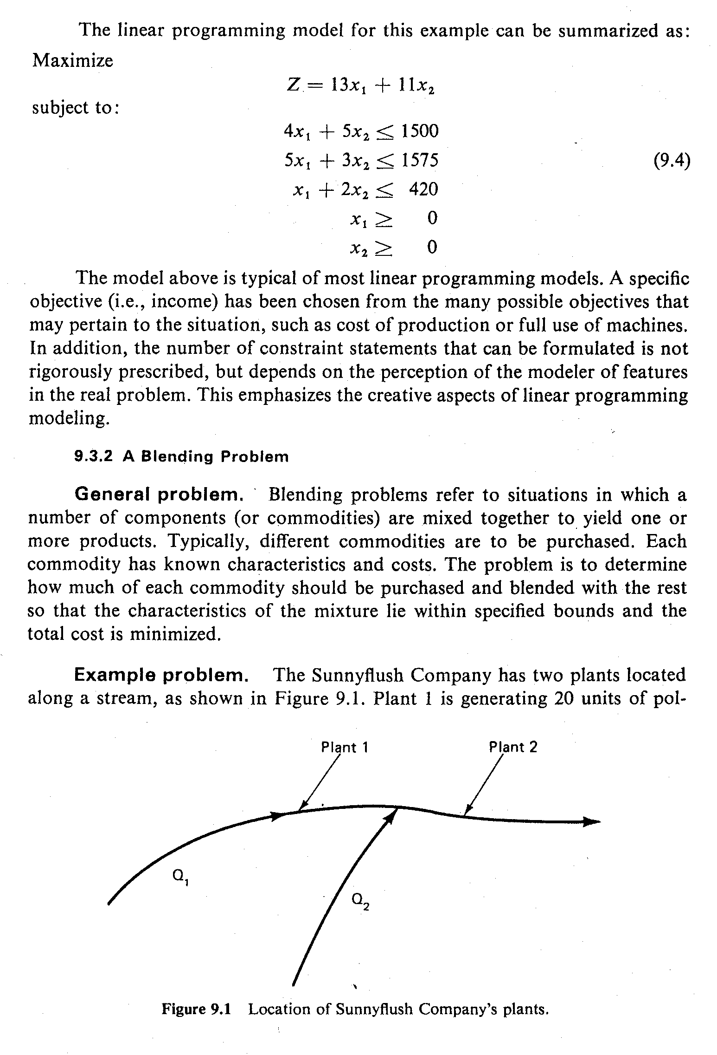
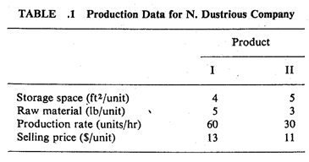
Developing LP Model (6)
The linear programming model for this example can be summarized as:
        x₁ / 60 + x₂ / 30 ≤ 7
      or x₁ + 2x₂ ≤ 420

Slide 18
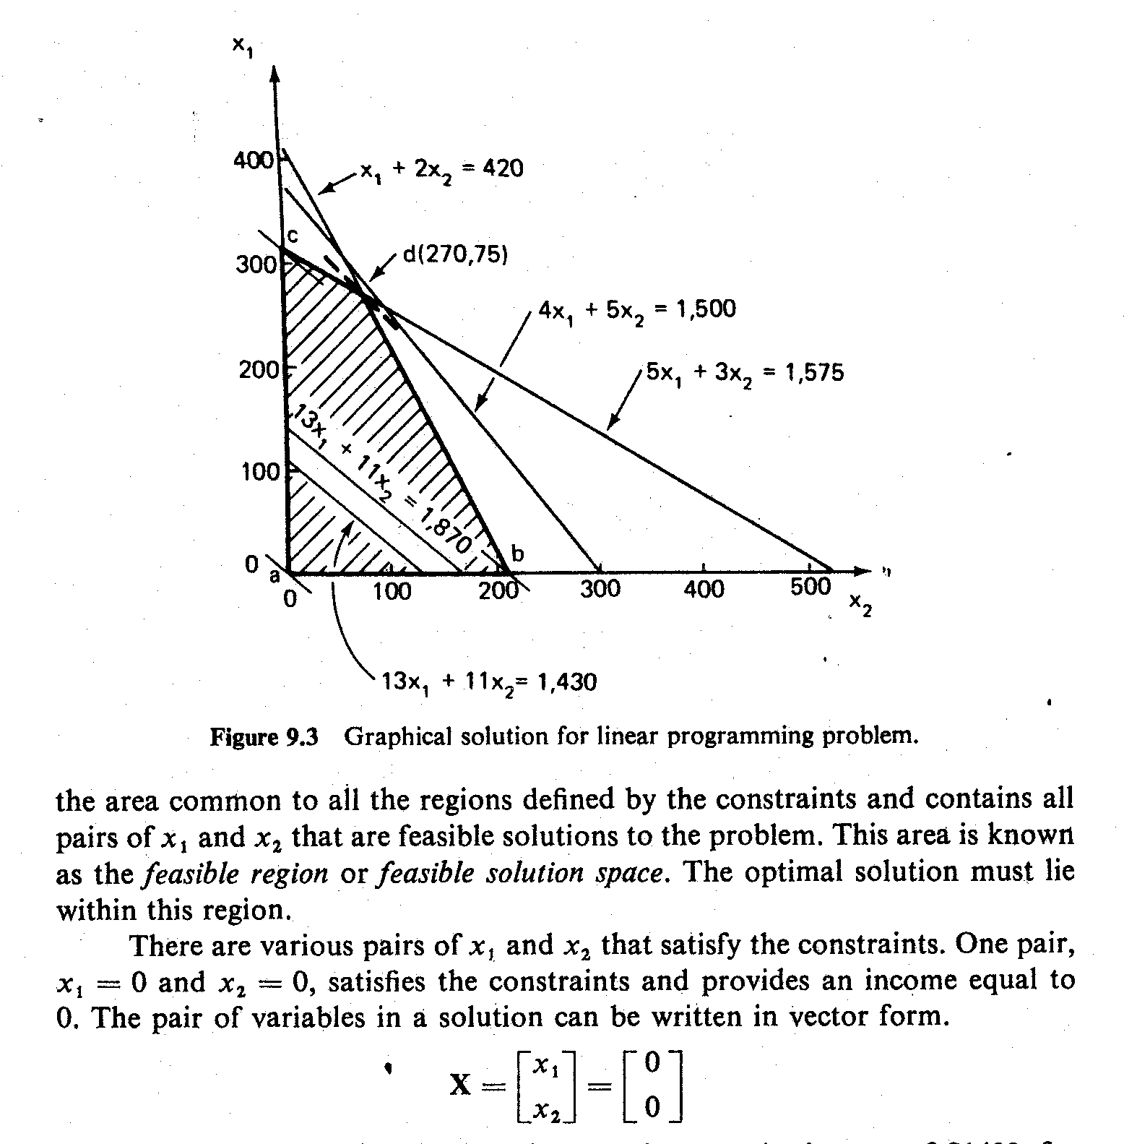
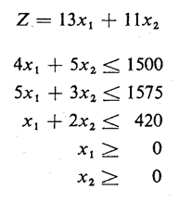
Graphical Solution to LP Problems (1)

Slide 19
Graphical Solution to LP Problems (2)
An equation of the form 4x₁ + 5x₂ = 1500 defines a straight line in the x₁-x₂ plane. An inequality defines an area bounded by a straight line. Therefore, the region below and including the line 4x₁ + 5x₂ = 1500 in the Figure represents the region defined by 4x₁ + 5x₂ ≤ 1500.
Same thing applies to other equations as well.
The shaded area of the figure comprises the area common to all the regions defined by the constraints and contains all pairs of x_{I} and x₂ that are feasible solutions to the problem.
This area is known as the feasible region or feasible solution space. The optimal solution must lie within this region.
There are various pairs of x₁ and x₂ that satisfy the constraints such as:

Slide 20
Graphical Solution to LP Problems (3)
Trying different solutions, the optimal solution will be:
X₁ = 270
X₂ = 75
This indicates that maximum income of $4335 is obtained by producing 270 units of product I and 75 units of product II.
In this solution, all the raw material and available time are used, because the optimal point lies on the two constraint lines for these resources.
However, 1500- [4(270) + 5(75)], or 45 ft² of storage space, is not used. Thus the storage space is not a constraint on the optimal solution; that is, more products could be produced before the company ran out of storage space. Thus this constraint is said to be slack.

Slide 21
Graphical Solution to LP Problems (4)
If the objective function happens to be parallel to one of the edges of the feasible region, any point along this edge between the two extreme points may be an optimal solution that maximizes the objective function. When this occurs, there is no unique solution, but there is an infinite number of optimal solutions.
The graphical method of solution may be extended to a case in which there are three variables. In this case, each constraint is represented by a plane in three dimensions, and the feasible region bounded by these planes is a polyhedron.

Slide 22
The Simplex Method (1)
When decision variables are more than 2, it is always advisable to use Simplex Method to avoid lengthy graphical procedure.
The simplex method is not used to examine all the feasible solutions.
It deals only with a small and unique set of feasible solutions, the set of vertex points (i.e., extreme points) of the convex feasible space that contains the optimal solution.

Slide 23
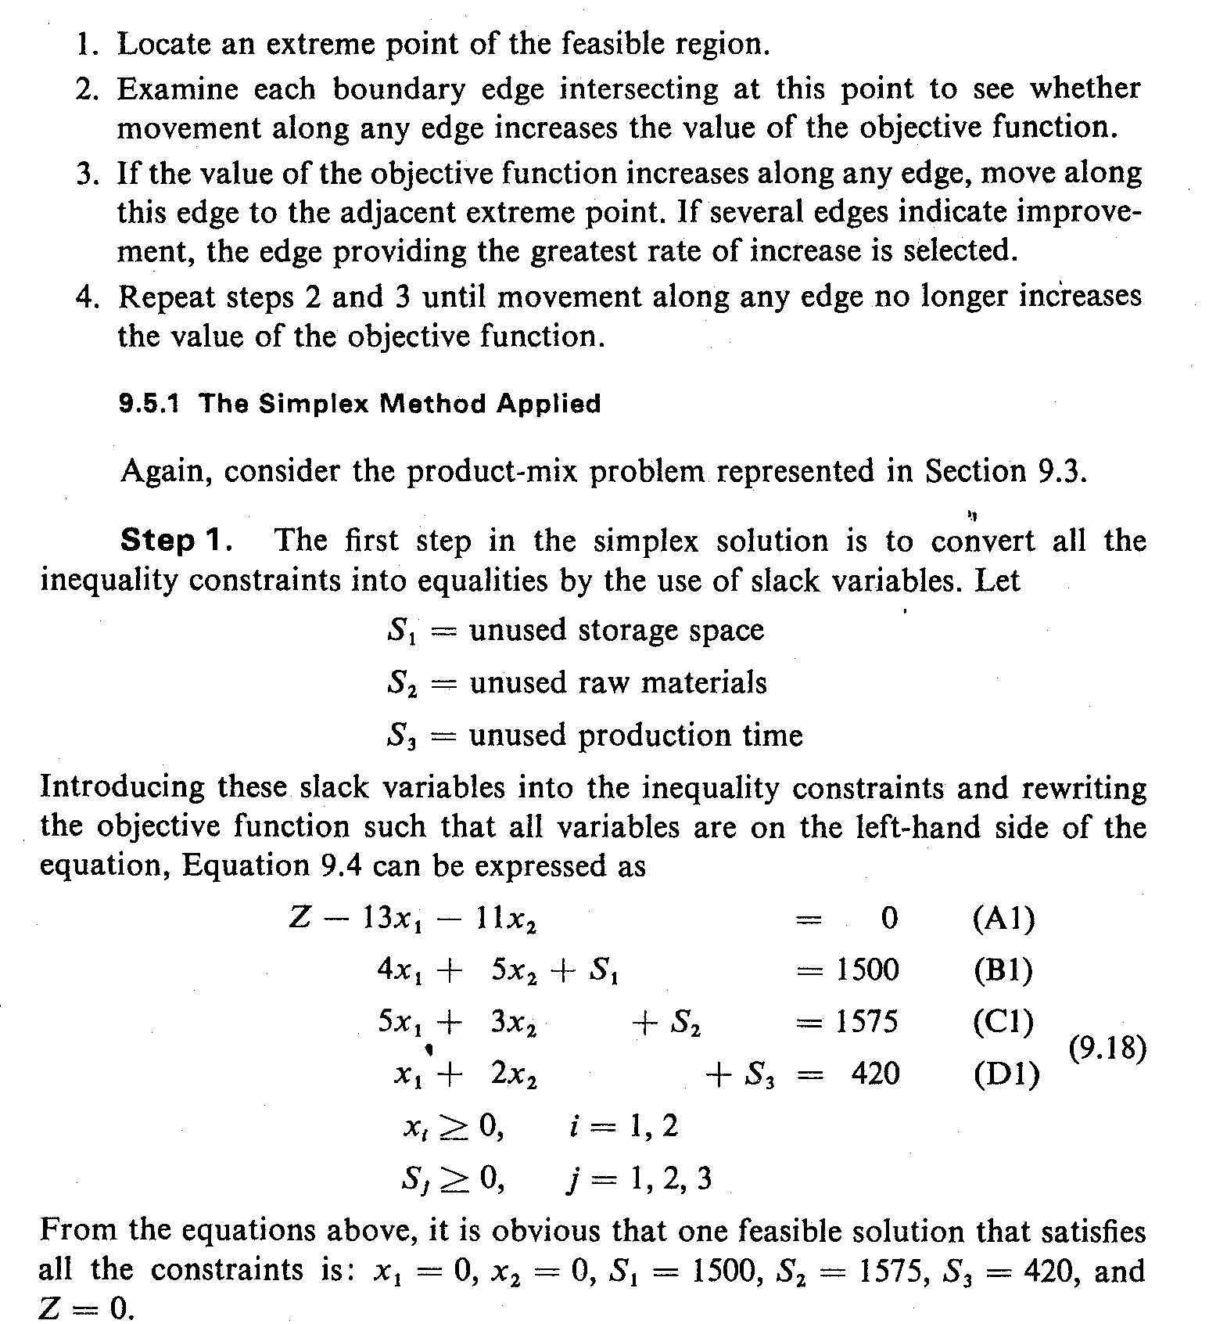
The Simplex Method (2)
Example: Product Mix Problem
Step 1: Convert all the inequality constraints into equalities by the use of slack variables. Let:
As already developed, the LP model is:
  …..Eq (4)

Slide 24
The Simplex Method (3)
Introducing these slack variables into the inequality constraints and rewriting the objective function such that all variables are on the left-hand side of the equation. Equation 4 can be expressed as:
  …..Eq (5)

Slide 25

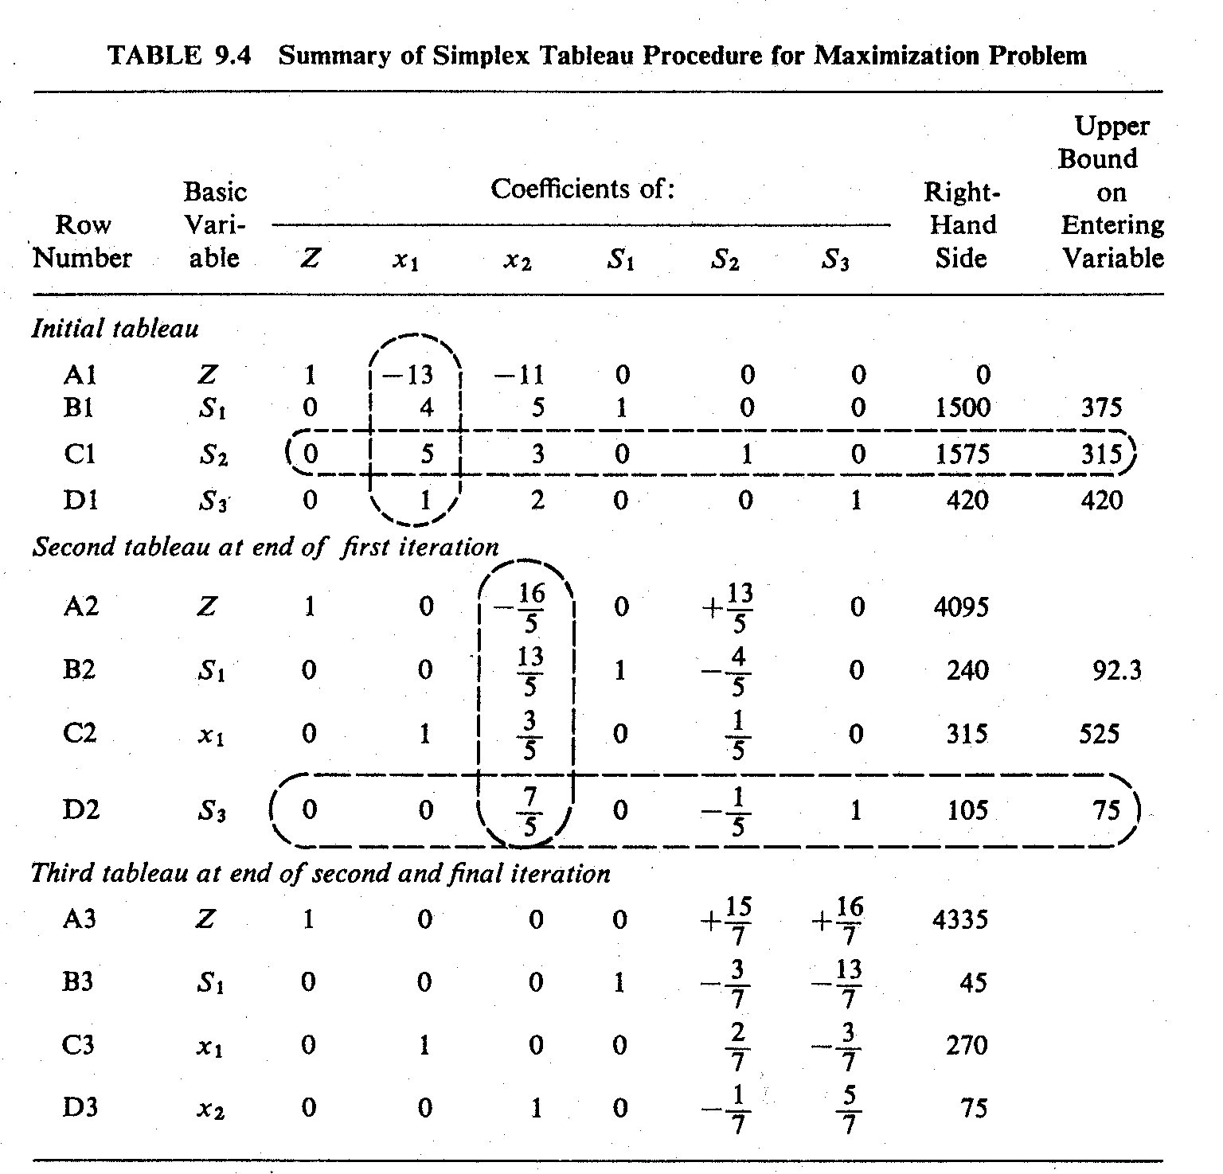
Simplex Tableau for Maximization (1)
Set up the initial tableau using Eq. (5).
In any iteration, a variable that has a nonzero value in the solution is called a basic variable.
Select the pivot column (determine which variable to enter into the solution mix). Choose the column with the “most negative” element in the objective function row.
Select the pivot row (determine which variable to replace in the solution mix). Divide the last element in each row by the corresponding element in the pivot column. The pivot row is the row with the smallest non-negative result.
Thus in the initial tableau S₁, S₂ and S₃ are basic variables.

Slide 26
Simplex Tableau for Maximization (2)
Enter the basic variables for the second tableau. The row sequence of the previous tableau should be maintained, with the leaving variable being replaced by the entering variable.
Use row operations to make all numbers in the pivot column equal to 0 except for the pivot number which remains as 1.

Slide 28
Marginal Values of Additional Resources (1)
The simplex solution yields the optimum production program for N. Dustrious Company.
  The company can maximize its sale income to $4335 by producing 270 units of product I and 75 units of product II.
  There will be no surplus of raw materials or production time.
  But there will be 45 units of unused storage space.
The managers are interested to know if it is worthwhile to increase its production by purchasing additional units of raw materials and by either expanding its production facilities or working overtime.

Slide 29
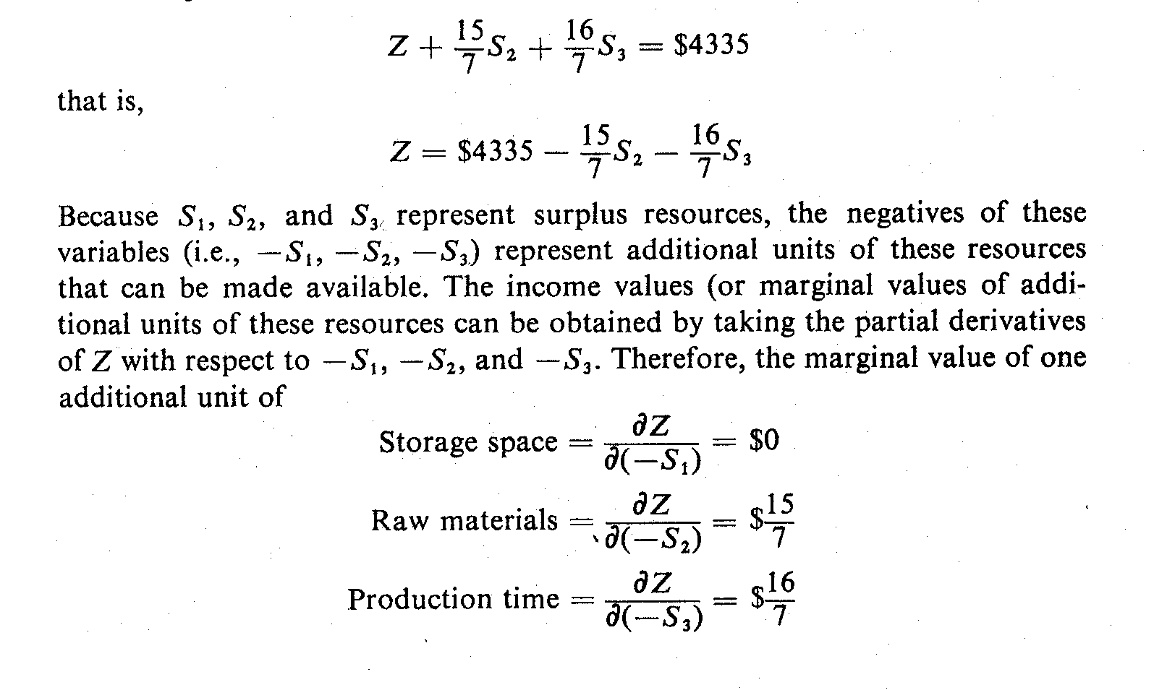
Marginal Values of Additional Resources (2)
The critical questions are:
  What is the income value (or marginal value) of each additional unit of each type of resources?
  What is the maximum cost ( or marginal cost) that they should be willing to pay for each additional unit of resources?
Answers to these questions can be obtained from the objective function in the last tableau of the simplex solution:

Slide 30
Marginal Values of Additional Resources (3)
Because S₁, S₂ and S₃ represent surplus resources, the negatives of these variables (i.e., -S₁, -S₂, -S₃) represent additional units of these resources that can be made available.
The income values (or marginal values of additional units of these resources can be obtained by taking the partial derivatives of Z with respect to -S₁, -S₂ and -S₃.
Therefore, the marginal value of one additional unit of:

Slide 31
Marginal Values of Additional Resources (4)
Thus, the marginal values of additional units of resources can be obtained directly from the coefficients of the objective function in the last tableau of a simplex solution.
The N. Dustrious Company should be willing to pay up to $15/7 for an additional unit of raw materials and $16/7 for an additional unit of production time.
If the actual cost of an additional unit (i.e., marginal cost) of these resources are smaller than the marginal value, the company should be able to increase its income by increasing production.
The marginal values above are valid, however, only as long as there is surplus storage space available.

Slide 32
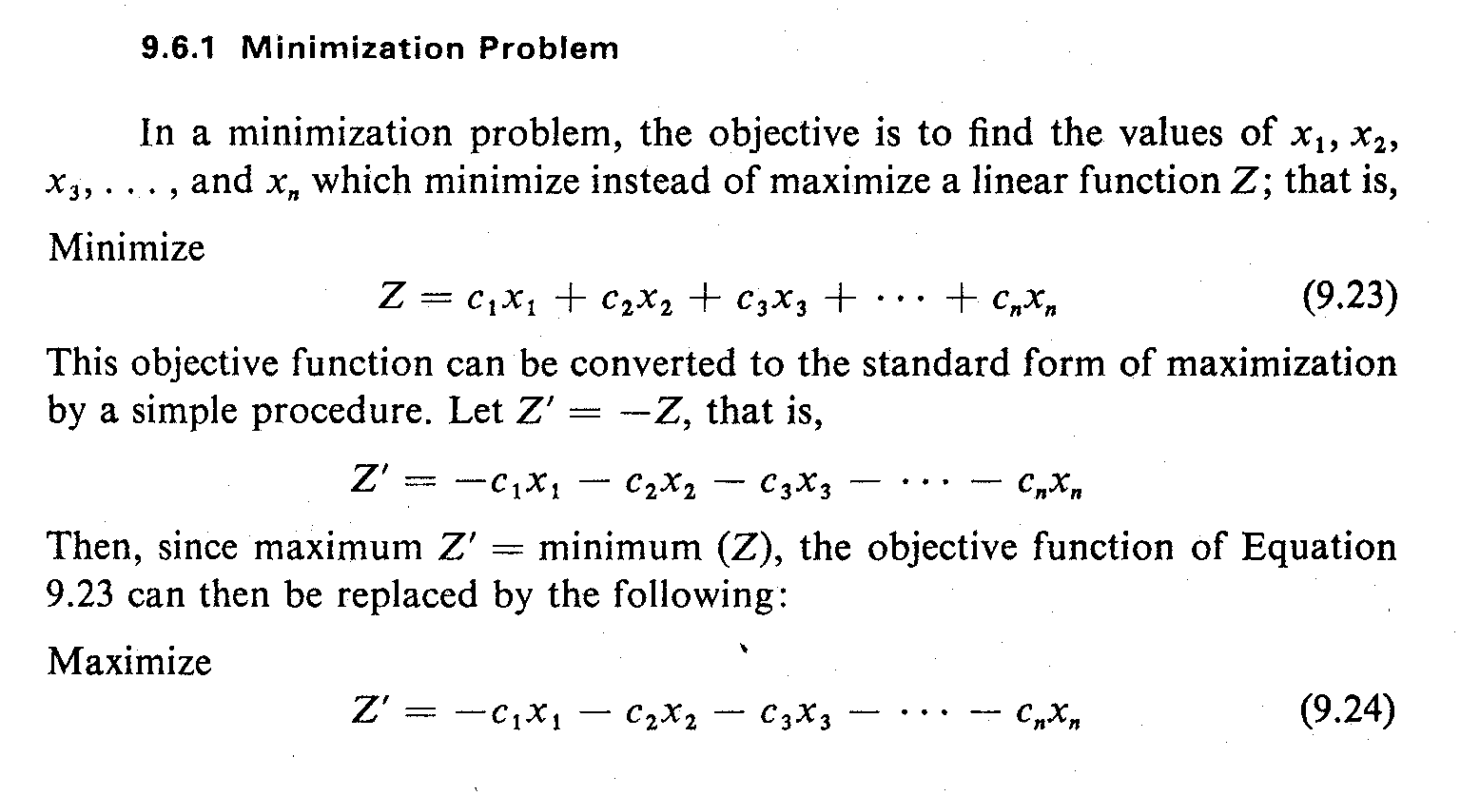
Complications in Simplex Method (1)
Minimization Problem – Solution 1
This objective function can be converted to the standard form of maximization. Let Z’ = -Z, so:
Since maximum Z’ = minimum (Z), the objective function becomes:
After the Z’ value is found, replace Z = -Z’

Slide 33
Complications in Simplex Method (2)
Minimization Problem – Solution 2
In the case of a minimization problem, an optimum solution is reached when:
  All the nonbasic variables have nonpositive coefficients in row 1 of the simplex tableau
  The entering variable will be one which has the largest positive coefficient in row I.
All the other operations in the simplex method remain unchanged.

Slide 34
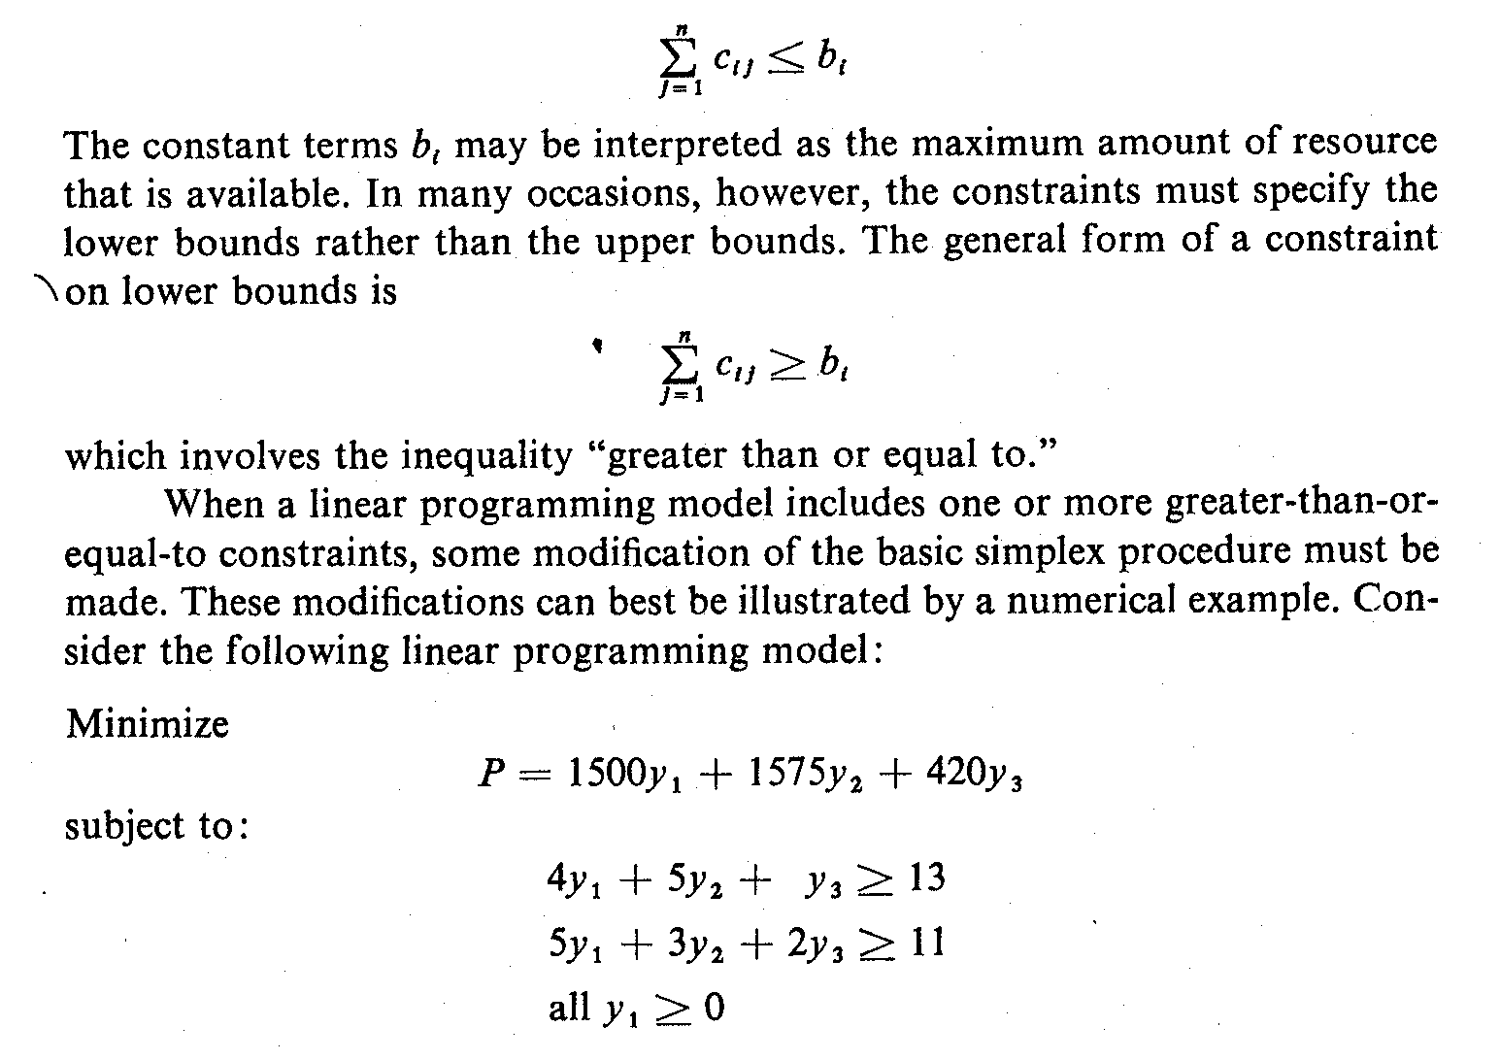
Complications in Simplex Method (3)
Greater- Than-Or-Equal- To Constraints
In the standard form of the linear programming model, the constraints are all expressed as less than or equal to (≤) a certain amount, that is,
In many occasions, the constraints must specify the lower bounds rather than the upper bounds such as:
which involves the inequality "greater than or equal to"

Slide 35
Complications in Simplex Method (4)
Example: Greater- Than-Or-Equal- To Constraints
…….Eq. (1)
To start the solution, slack variables must first be assigned to convert all in-equalities to equalities. Let S₁ and S₂ be slack variables.
Re- arrange the objective function so that all the variables are on the left-hand side of the equation.

Slide 36
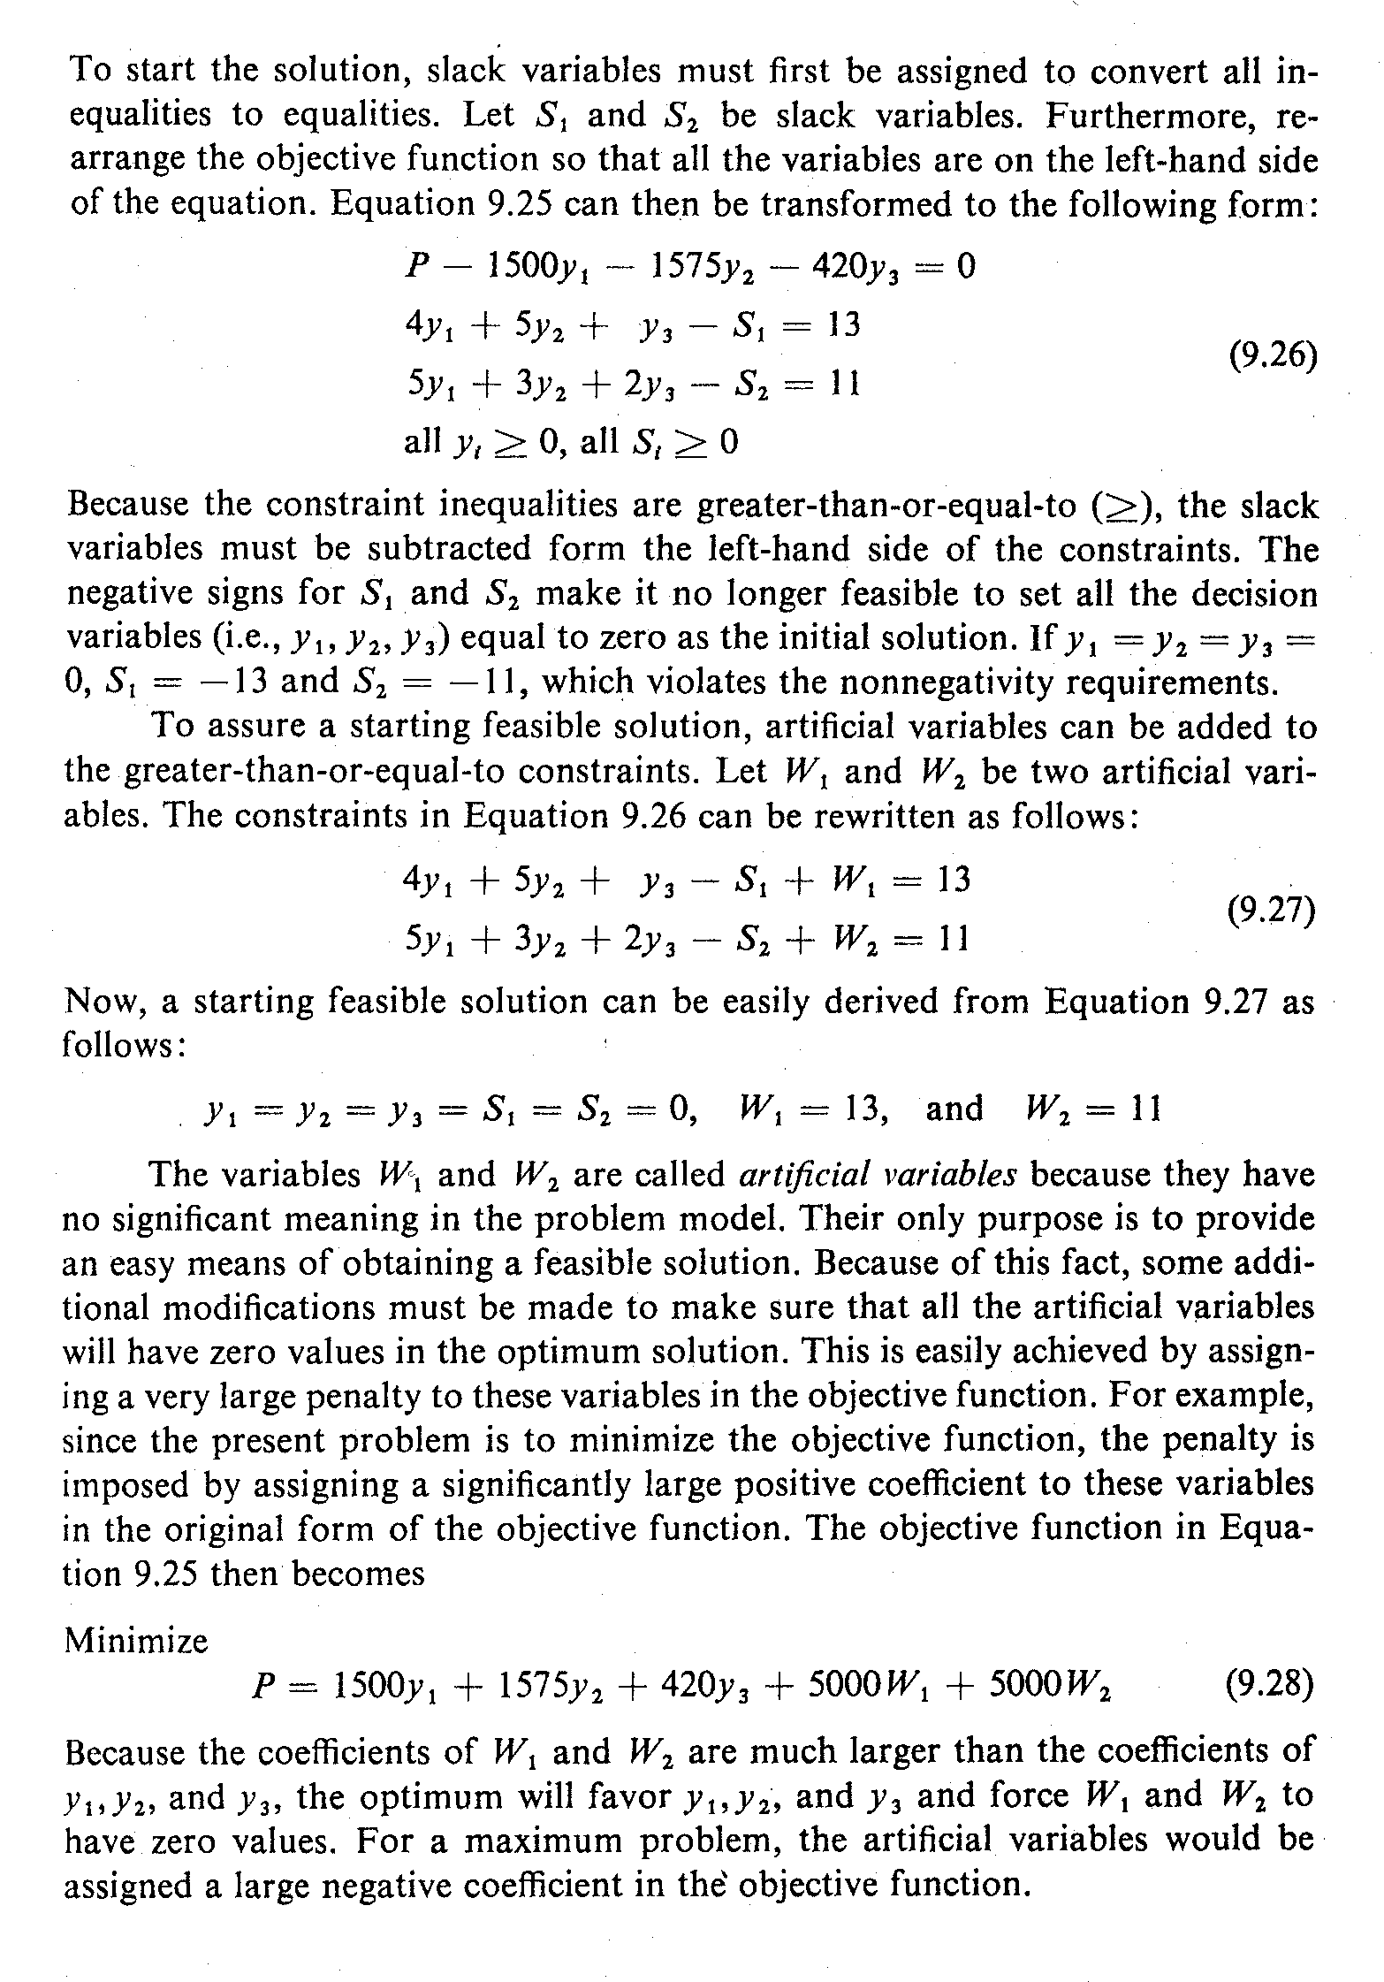
Complications in Simplex Method (5)
…….Eq. (2)
The negative signs for S₁ and S₂ make it no longer feasible to set all the decision variables (i.e., y₁, y₂, y₃) equal to zero as the initial solution.
To assure a starting feasible solution, artificial variables can be added to the greater-than-or-equal-to constraints. Let W₁ and W₂ be two artificial variables. Hence the Eq. (2) becomes:
…….Eq. (3)

Slide 37
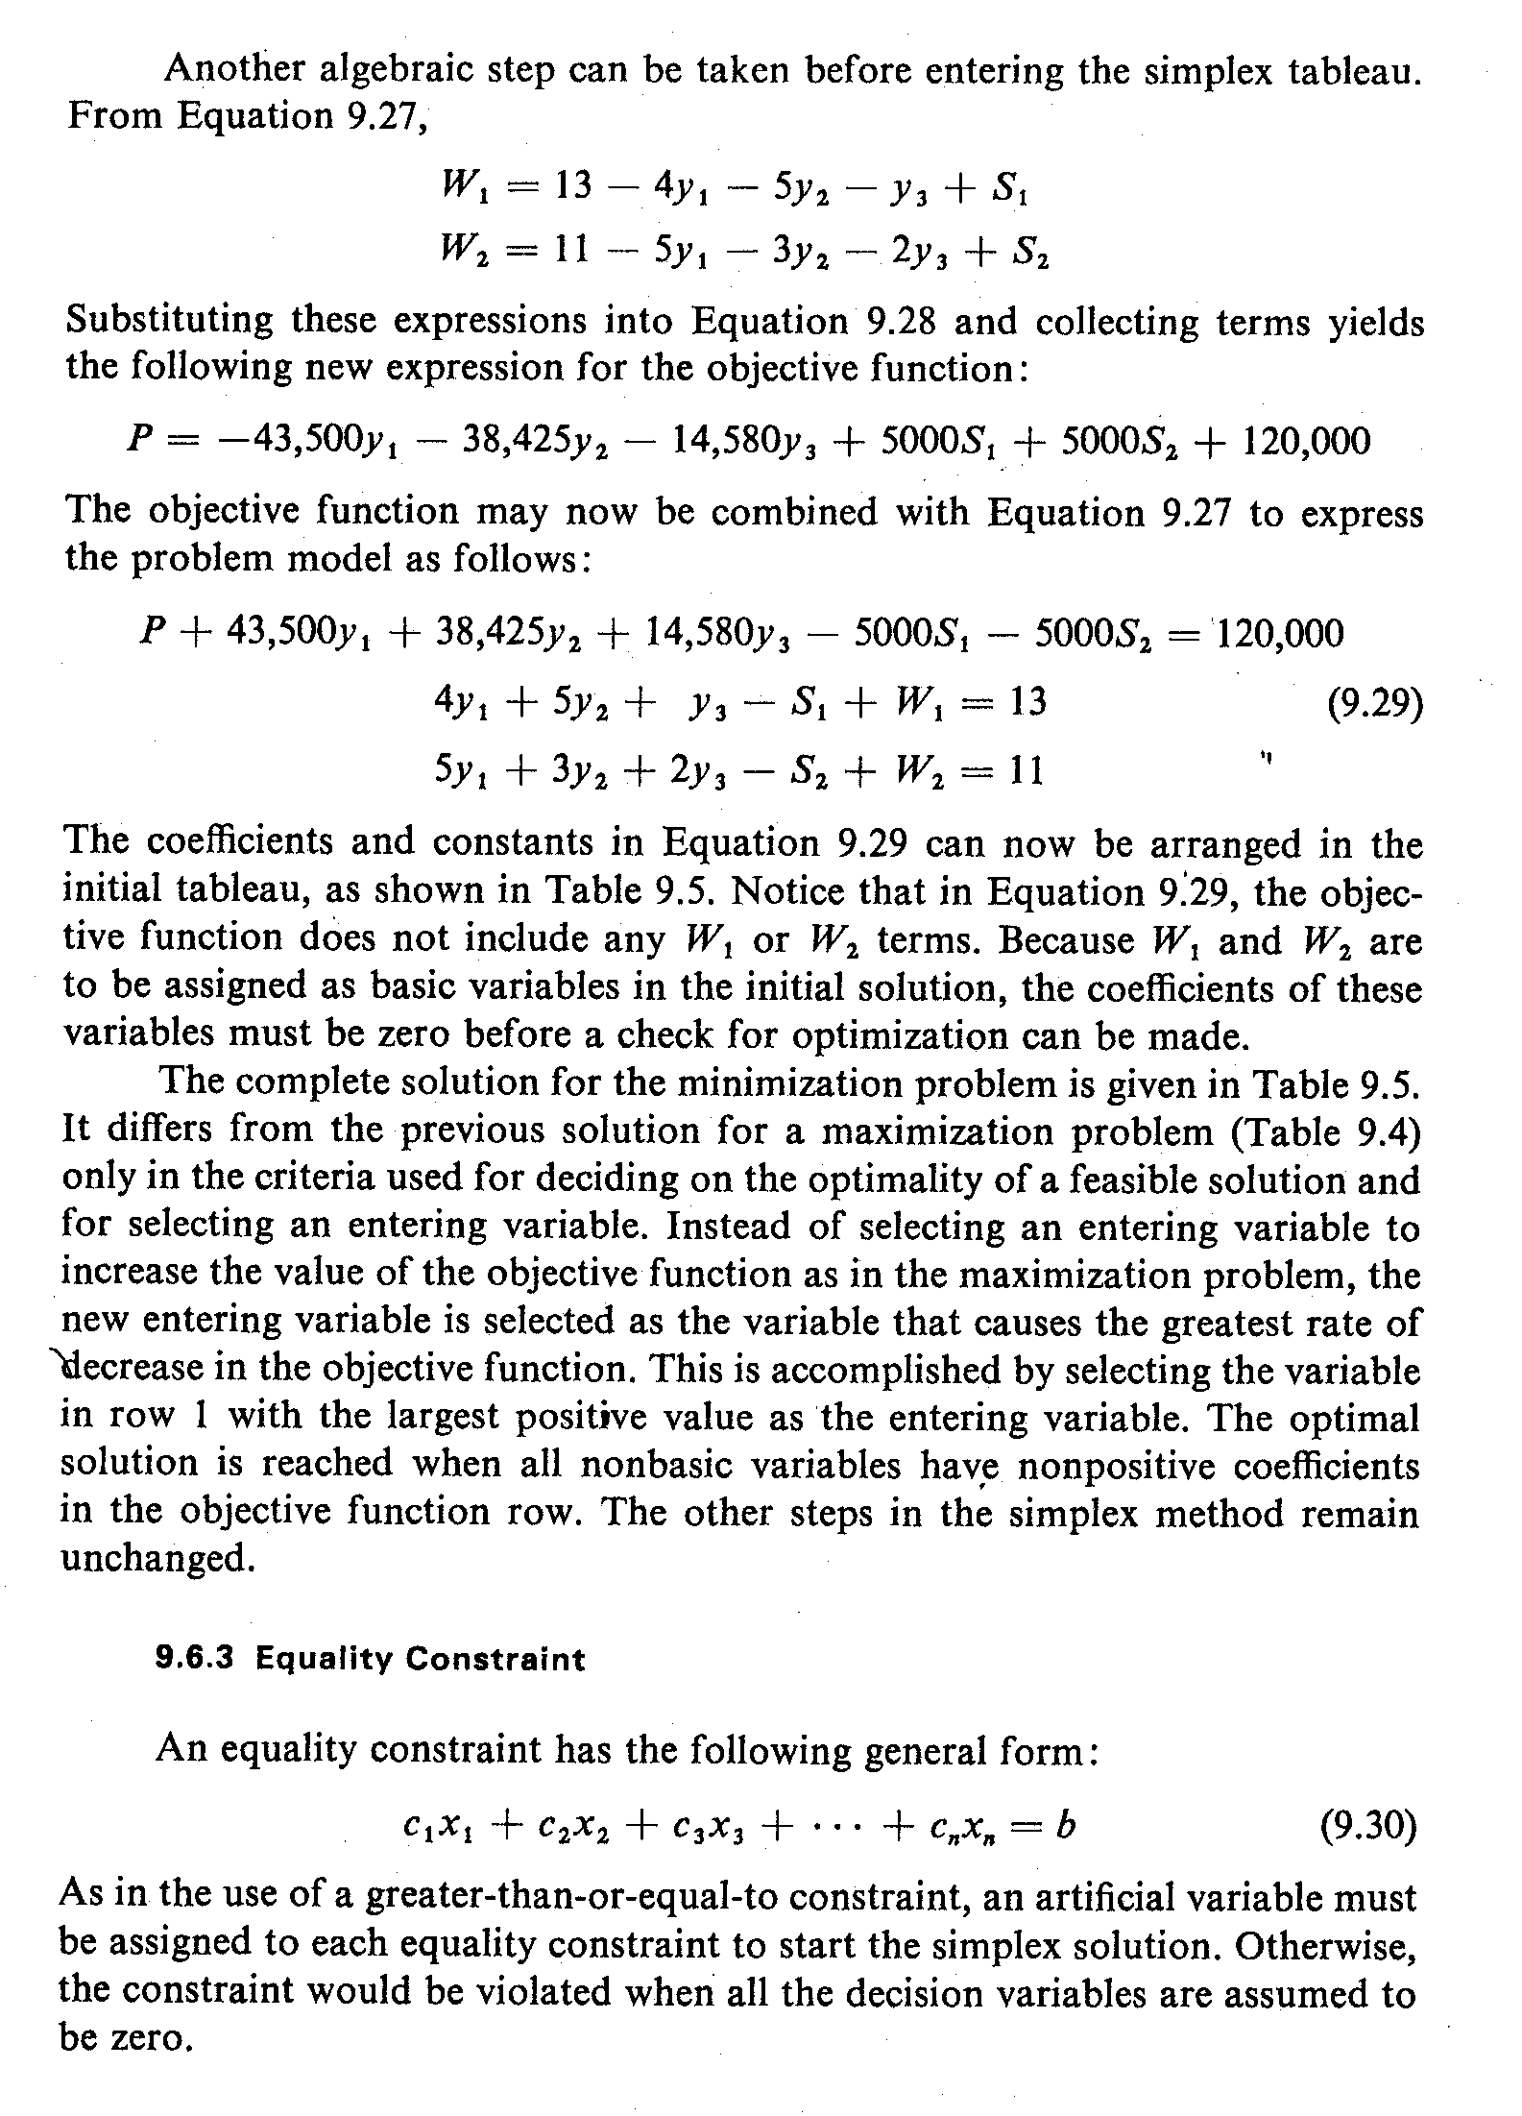
Complications in Simplex Method (6)
A starting feasible solution can be easily derived from Eq. (3) as follows:
The objective function in Eq. (3) then becomes:
…….Eq. (4)
From Eq. (3):

Slide 38
Complications in Simplex Method (7)
Substituting these expressions in Eq. (4) yields the following new expression for the objective function:
The objective function may now be combined with Eq. (3) to express the problem model as follows:
…….Eq. (5)
The coefficients and constants in Eq. (5) can now be arranged in the Tableau format as shown in next slide.

Slide 39
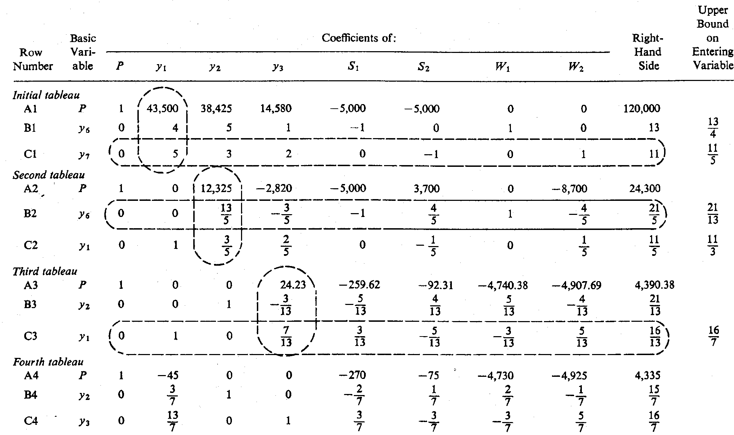
Complications in Simplex Method (8)

Slide 40
Complications in Simplex Method (9)
Equality Constraint
An equality constraint has the following general form:
An artificial variable must be assigned to each equality constraint to start the simplex solution. Otherwise, the constraint would be violated when all the decision variables are assumed to be zero.
Sometimes a decision variable may take on either negative or positive values. It x₁ is unrestricted in sign, replace it throughout the model by the difference of two new nonnegative variables:
x_{j} = x_{j}’ – x_{j}’’ where x_{j}’ ≥ 0, x_{j}’’ ≥ 0

Slide 41
Complications in Simplex Method (10)
Equality Constraint
Because x_{j}’ and x_{j}’’ can have any nonnegative values their difference (x_{j}’ –x_{j}’’) can have any value (positive or negative). After substitution, the simplex method can proceed with just nonnegative variables.

Slide 42
Complications in Simplex Method (11)
Degenerate Solution
If the number of basic variables is fewer than the number of constraints in a solution, the solution is said to be degenerate.
A zero constant term for one or more basic variables in any iteration of the simplex solution would be a clear indication of a degenerate solution.
The normal simplex procedure cannot solve a degenerate problem.
Advanced methods are available to solve degenerate problems.

Slide 43
Complications in Simplex Method (12)
Integer and Mixed-Integer Problems
A linear programming problem in which all the decision variables must have integer values is called an integer programming problem.
A problem in which only some of the decision variables must have integer values is called a mixed-integer programming problem.
Sometimes, some (or all) of the decision variables must have the value of either 0 or 1. Such problems are then called zero-one mixed-integer programming problems.
Simplex method cannot be used to such problems. Advanced methods are available for this purpose.

Slide 44
Duality (1)
With every linear programming problem, there is associated another linear programming problem which is called the dual of the original (or the primal) problem.
Formulating the Dual problem
Consider again the production mix problem of N. Dustrious Company.
Suppose that the company is considering leasing out the entire production facility to another company, and it must decide on the minimum daily rental price that will be acceptable.
This decision problem can also be formulated as a linear programming problem.

Slide 45
Duality (2)
Let y₁, y₂ and y₃ represent the unit price of each unit of storage space, raw materials, and production time, respectively.
The unit prices are in fact the income values of each unit of resource to the N. Dustrious Company.
There are available 500 ft² of storage space, 1575 lb of raw materials, and 420 minutes of production time per day.
Thus the total income value (P) of all the available resources may be expressed as follows :
P = 1500y₁ + 1575y₂ + 420y₃
The objective of the problem is to minimize P subject to the condition that the N. Dustrious Company will earn at least as much income as when it operates the production facility itself.

Slide 46
Duality (3)
Since the market value (or selling price) of 1 unit of product I is $13 and it requires 4 ft² of storage space, 5 lbs of raw materials, and 1 minute of production time, the following constraint must be satisfied:
4y₁ + 5y₂ + 5y₃ ≥ 13
Similarly, for Product II:
        5y₁ + 3y₂ + 2y₃ ≥ 11
In addition, the unit prices y₁, y₂ and y₃ must all be greater than or equal to zero.

Slide 47
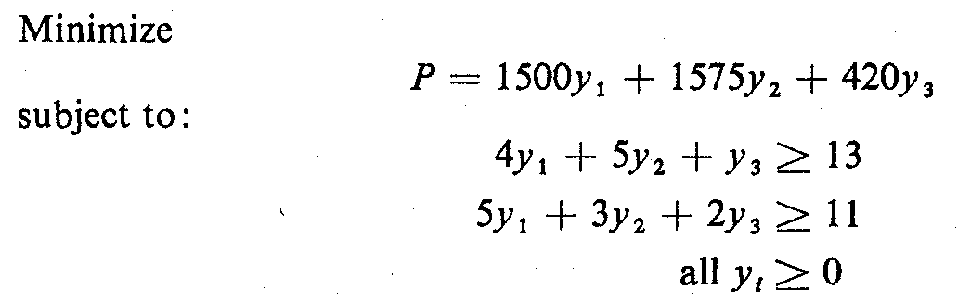
Duality (4)
The new linear programming problem may now be summarized as follows :
…….Eq. (1)
The following interesting observations can now be made:
  P = Z = $4335
  y₁ = $0; y₂ = $15/7 and y₃ = $16/7
This problem is the same as maximization problem in the previous example and can now be solved accordingly.

Slide 48
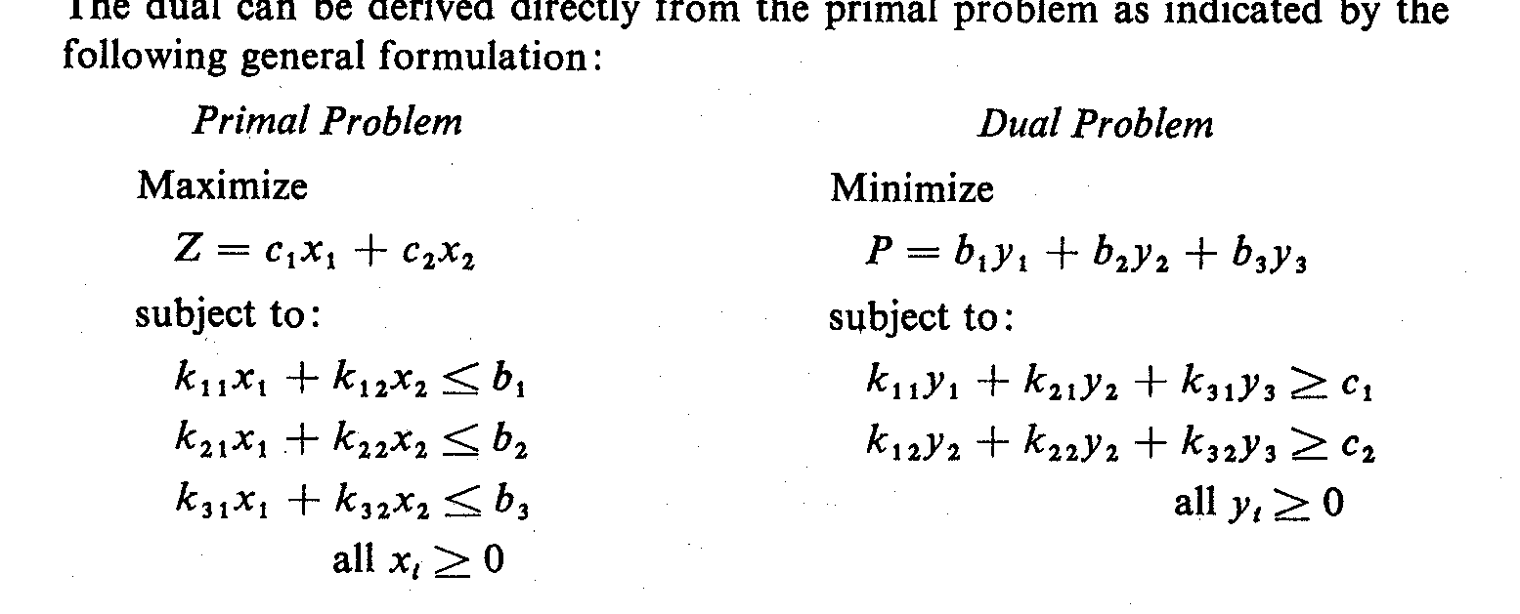
Duality (5)
The primal-dual Relationship
(1A)
(1B)
To produce 1 unit of A_{j}, j=1,2,...,n, we need k_{1j} B₁, k_{2j} B₂,..., k_{mj} B_{m}. Thus the selling amount of materials used to produce 1 unit of of A_{j} is:
t_{j} = k_{1j}y₁ + k_{2j}y₂ + ... + k_{mj}y_{m} and we want t_{j} ≥ c_{j} j = 1, 2, ..., n c_{j} = price of 1 unit of Aj.
Dual Problem: We need to determine the selling price y_{i} per unit of material B_{i} (i = 1, 2, ..., m) such that the total selling amount
P = b₁ y₁ + b₂ y₂ + ... + b_{m} y_{m} (1B)
is as low as possible and is still guaranteed to be better than producing and selling the item.

Slide 49
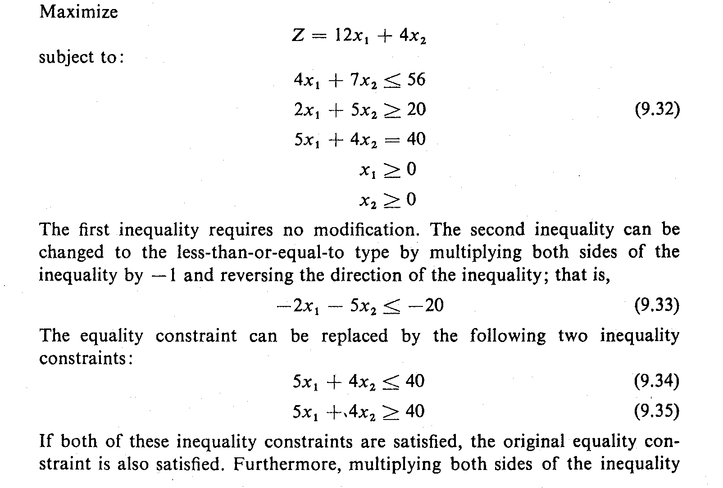
Duality (6)
Complete Regularization of the Primal Problem
Consider the following primal problem:
The first inequality requires no modification.

Slide 50
Duality (7)
The second inequality can be changed to the less-than-or-equal-to type by multiplying both sides of the inequality by -1 and reversing the direction of the inequality; that is,
The equality constraint can be replaced by the following two inequality constraints:
If both of these inequality constraints are satisfied, the original equality constraint is also satisfied.

Slide 51
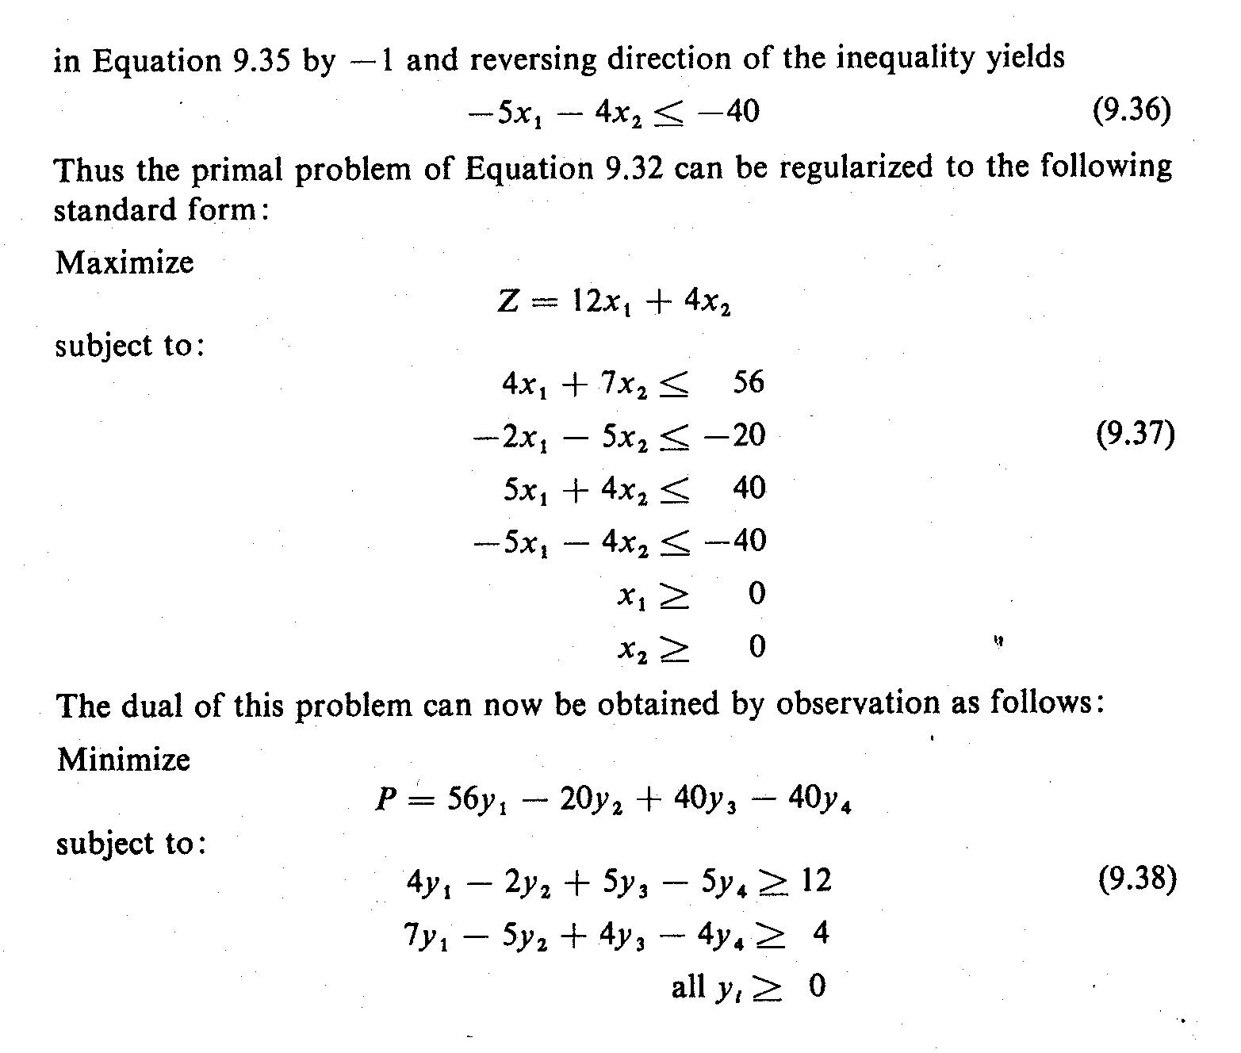
Duality (8)
Multiplying both sides of the inequality by –1 and reversing the direction of the inequality yields:
The primal problem can now take the following standard form:

Slide 52
Duality (9)
The dual of this problem can now be obtained as follows:
Video: Simplex Method - Standard Maximization Problem
https://www.youtube.com/watch?v=XK26I9eoSl8

